Slide 1

SENTIMENT ANALYSIS
Nina Fiore and Hani Haider

Slide 2

Overview
Stanford University dataset containing Amazon users’ review data, 2005 - 2014
(28978, 9)
reviewerID - ID of the reviewer
asin - ID of the product
reviewerName - name of the reviewer
helpful - helpfulness rating of the review
reviewText - text of the review
overall - rating of the product
summary - summary of the review
unixReviewTime - time of the review (unix time)
reviewTime - time of the review (raw)

Slide 3



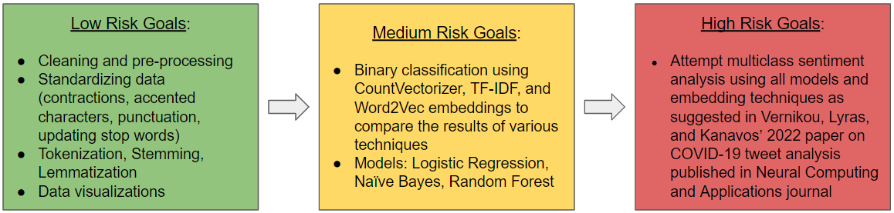
Project Milestones

Slide 4
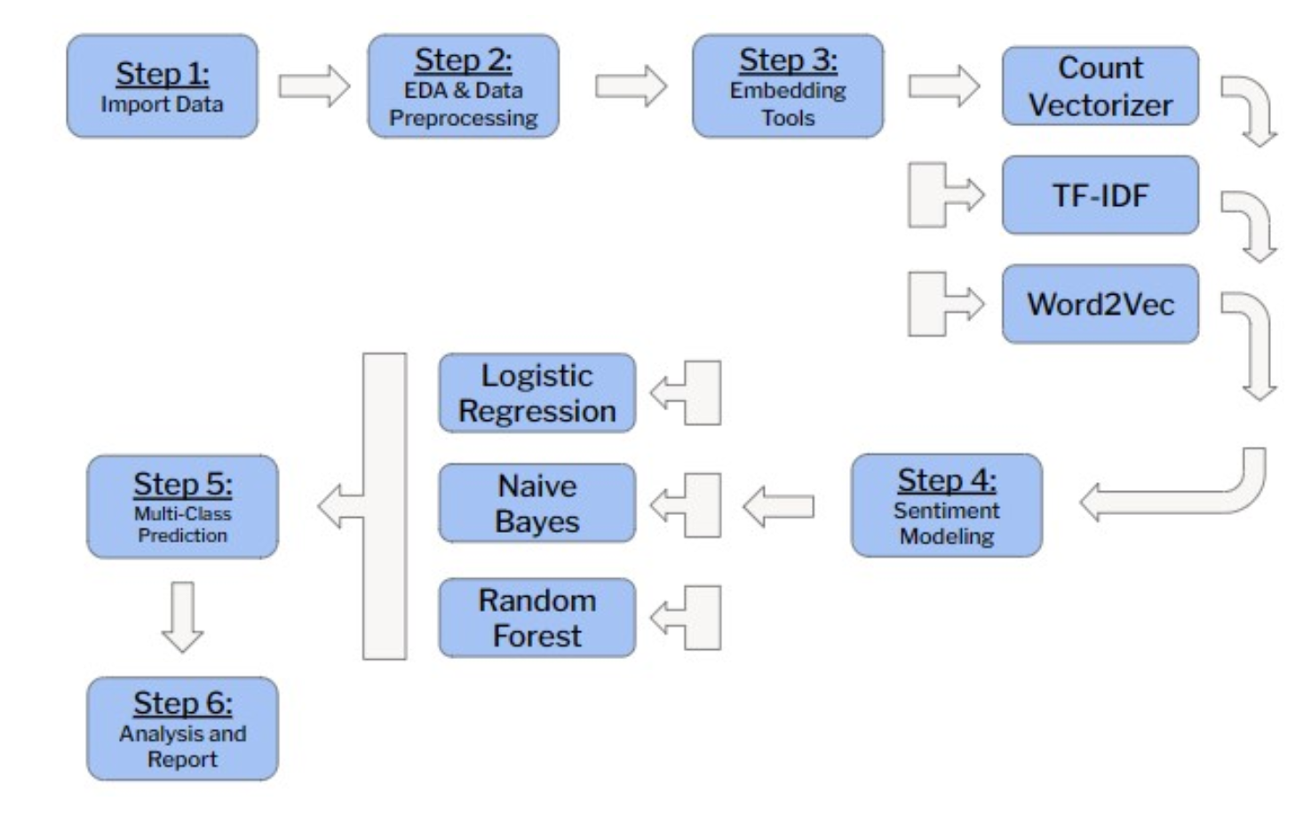
Project Design

Slide 5
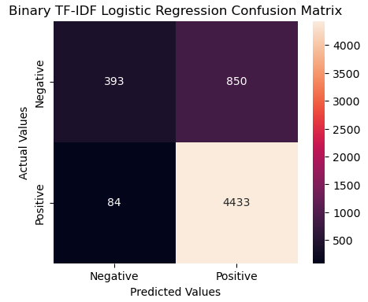
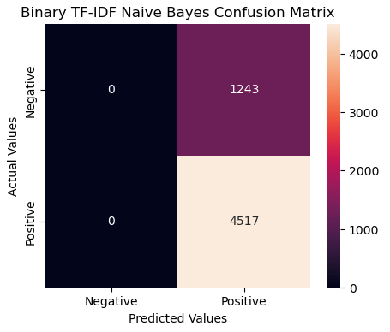
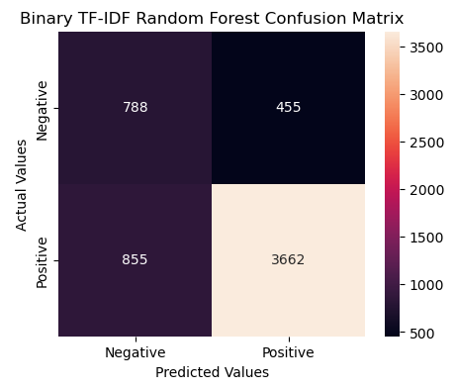
Results
84%
78%
68%

Slide 6
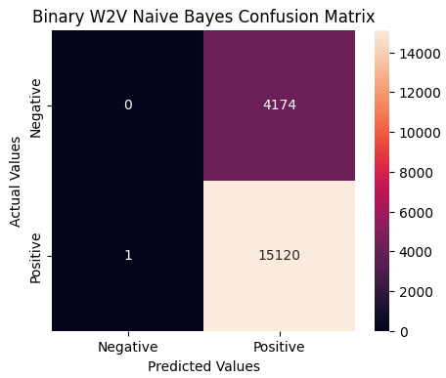
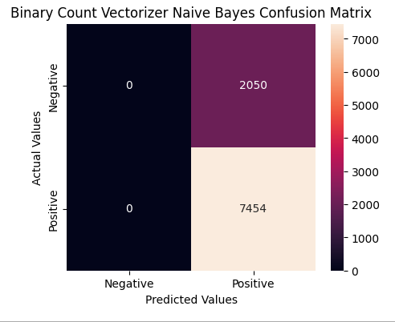
Results

Slide 7
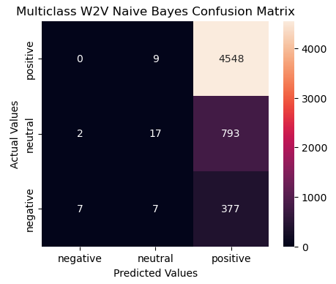
Results

Slide 8
Accuracy Scores
BINARY (POS/NEG) | Word2Vec | TF-IDF | Count Vectorizer
Logistic Regression | 78% | 84% | 83%
Naïve Bayes | 22% | 78% | 82%
Random Forest | 80% | 68% | 79%
MULTI (POS/NEU/NEG) | Word2Vec | TF-IDF | Count Vectorizer
Logistic Regression | 80% | 80% | 80%
Naïve Bayes | 79% | 79% | 77%
Random Forest | 79% | 78% | 78%

Slide 9







References
Amazon Reviews Dataset [April 26, 2016]. Stanford University. [Online] available: http://snap.stanford.edu/data/amazon/productGraph/categoryFiles/reviews_Beauty_10.json.gz [accessed February 26, 2023].
Fang, X. and J. Tao. “Toward multi-label sentiment analysis: a transfer learning based approach” [2020]. Journal of Big Data, 7. [Online] available: https://doi.org/10.1186/s40537-019-0278-0 [accessed March 1, 2023].
Vernikou, S., Lyras, S. and A. Kanavos. “Multiclass sentiment analysis on COVID-19-related tweets using deep learning models” [August 6, 2022]. Neural Computational Application 34(22). [Online] available: https://www.ncbi.nlm.nih.gov/pmc/articles/PMC9362523/ [accessed February 23, 2023].
Notes:
Kaggle
Toward Data Science

